Slide 1
Software Engineering
(CSI 321)
Requirements Engineering
&
Software Maintenance

Slide 2
What is Requirements Engineering(RE) ?
The process of establishing the services that the system should provide and the constraints under which it must operate is called requirements engineering.
  RE helps software engineers to better understand the problem they will work to solve.
  RE builds a bridge to design and construction and establishes a solid base for them.
  RE is a SE action that begins during the communication activity & continues into the modeling activity

Slide 3
Why RE is important?
Designing & building an elegant computer program that solves wrong problem serves no one’s needs. That’s why it is necessary to understand requirements before design & construction of a computer-based system can begin.
RE helps software engineers better understand the problems they are trying to solve.
  Without RE, the resulting software has a high probability of not meeting the customers’ needs.
  Therefore, RE must be adapted to the needs of the process, project, the product, and the people doing the work.

Slide 4
What are Requirements?
The requirements for a system are the descriptions of the services provided by the system and its operational constraints.
The requirements reflect the needs of customers for a system.
The requirements are the specified essential attributes for a system.
Business changes inevitably lead to changing requirements.
Systems have multiple stakeholders with different requirements.

Slide 5
Requirements categories
User requirements:
  Are statements, in a natural language plus diagrams, of what services the system is expected to provide and the constraints under which it must operate
  High-level abstract requirements
System requirements:
  Set out the system’s functions, services and operational constraints in detail
  Detailed description of what the system should do
  May be functional or non-functional

Slide 6
System requirements
System Requirements may be functional or non- functional
Functional requirements are statements of services the system should provide, how the system should react to particular inputs and how the system should behave in particular situations.
Non-functional requirements are constraints on the services or functions offered by the system, e.g. timing constraints, constraints on the development process and standards.

Slide 7
The RE process
The RE process is accomplished through the execution of seven distinct functions:
    Inception
    Elicitation
    Elaboration
    Negotiation
    Specification
    Validation
    Requirements Management

Slide 8
The RE process
Inception—Establish a basic understanding of the problem and the nature of the solution.
Elicitation—Draw out the requirements from stakeholders.
Elaboration—Create an analysis model that represents information, functional, and behavioral aspects of the requirements.
Negotiation—Agree on a deliverable system that is realistic for developers and customers.
Specification—Describe the requirements formally or informally.
Validation—Review the requirement specification for errors, ambiguities, omissions, and conflicts.
Requirements management—Manage changing requirements.

Slide 9
Problems of Requirements Analysis
What are the problems of requirements analysis?
Stakeholders don’t know what they really want
Stakeholders express requirements in their own terms
Different stakeholders may have conflicting requirements
Organizational and political factors may influence the system requirements
The requirements change during the analysis process. New stakeholders may emerge and the business environment change.

Slide 10
Software maintenance
Software maintenance is the process of changing a system after it has been delivered.
  Modifying a program after it has been put into use.
  Maintenance does not normally involve major changes to the system’s architecture.
  Changes are implemented by modifying existing components and adding new components to the system.

Slide 11
Software change
Software change is inevitable
  New requirements emerge when the software is used
  The business environment changes
  Errors must be repaired
  New computers and equipment is added to the system
  The performance or reliability of the system may have to be improved
Software development does not stop when a system is delivered but continues throughout the lifetime of the system.
A key problem for organizations is implementing and managing change to their existing software systems.

Slide 12
Maintenance is inevitable
The system requirements are likely to change while the system is being developed because the environment is changing. Therefore a delivered system won't meet its requirements!
Systems are tightly coupled with their environment. When a system is installed in an environment it changes that environment and therefore changes the system requirements.
Systems MUST be maintained, if they are to remain useful in an environment.

Slide 13
Types of Software Maintenance
Maintenance to repair software faults –Changing a system to correct deficiencies in the way meets its requirements.
  Corrective Maintenance
Maintenance to adapt software to a different operating environment: Changing a system so that it operates in a different environment (computer, OS, etc.) from its initial implementation.
  Adaptive Maintenance
Maintenance to add to or modify the system’s functionality: Modifying the system to satisfy new requirements.
  Perfective Maintenance

Slide 14
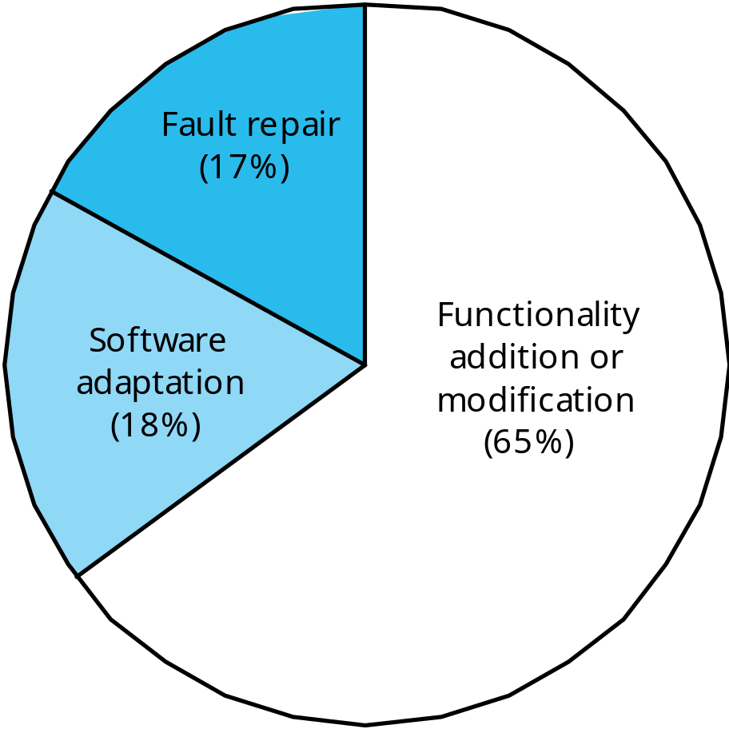
Distribution of maintenance effort

Slide 15
Maintenance costs
Usually greater than development costs (2* to 100* depending on the application).
Affected by both technical and non-technical factors.
Increases as software is maintained. Maintenance corrupts the software structure so makes further maintenance more difficult.
Ageing software can have high support costs.
It is usually cost-effective to invest effort in designing and implementing a system to reduce maintenance costs.

Slide 16
Escalating Maintenance Costs
1970s: Maintenance cost: 35-40%
Development cost: 65-60%
1980s: Maintenance cost: 40-60%
Development cost: 60-40%
1990s: Maintenance cost: 70-80%
Development cost: 30-20%

Slide 17
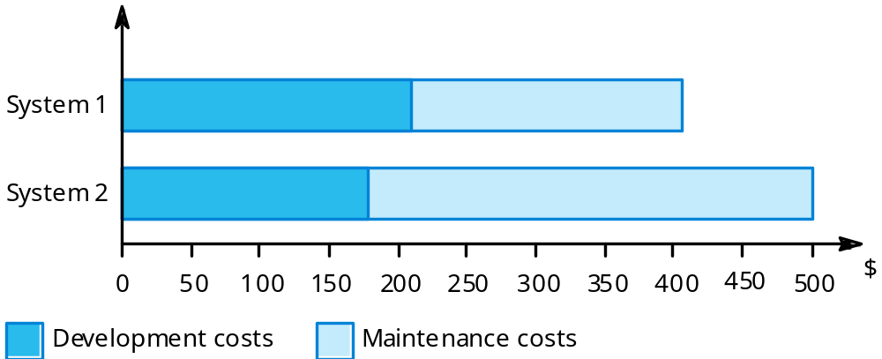
Development/maintenance costs

Slide 18
Maintenance cost factors
Team stability
  Maintenance costs are reduced if the same staff are involved with them for some time.
Contractual responsibility
  The developers of a system may have no contractual responsibility for maintenance so there is no incentive to design for future change.
Staff skills
  Maintenance staff are often inexperienced and have limited domain knowledge.
Program age and structure
  As programs age, their structure is degraded and they become harder to understand and change.

Slide 19
Software Evolution Process
Evolution processes depend on
  The type of software being maintained
  The development processes used
  The skills and experience of the people involved
Proposals for change are the driver for system evolution. Change identification and evolution continue throughout the system lifetime.

Slide 20
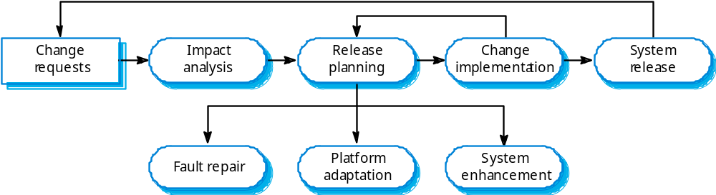
The system evolution process

Slide 21
Urgent change requests
Urgent changes may have to be implemented without going through all stages of the software engineering process.
Three reasons for urgent changes:
  If a serious system fault has to be repaired
  If changes to the system’s environment (e.g. an OS upgrade) have unexpected effects
  If there are business changes that require a very rapid response (e.g. the release of a competing product)

Slide 22
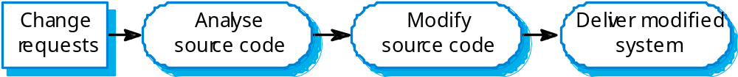
Emergency repair

Slide 23
Maintenance Activities : The Roles
Maintenance activities are similar to those of development: analyzing requirements, evaluating system and program design, writing or rewriting code, testing changes, and updating documentation.
The people who performs maintenance – analysts, programmers, testers, and designers –have similar roles.
However, programmers play a much larger role in maintenance ( changes often require an intimate knowledge of the structure and content of the system’s code).

Slide 24
Maintenance Activities
How to manage the Maintenance Activities for a particular system?
The team that develops a system is not always used to maintain the system once it is operational.
Often, a separate maintenance team is employed to insure that the system runs properly.
  There are positive and negative aspects to using a separate maintenance team
Sometimes, a separate group of analysts, programmers, and designers is designated as the maintenance team.

